Slide 1

MARIO KART 8 OPTIMIZATION

Slide 2

COLON CANCER ANALYSIS

Slide 3
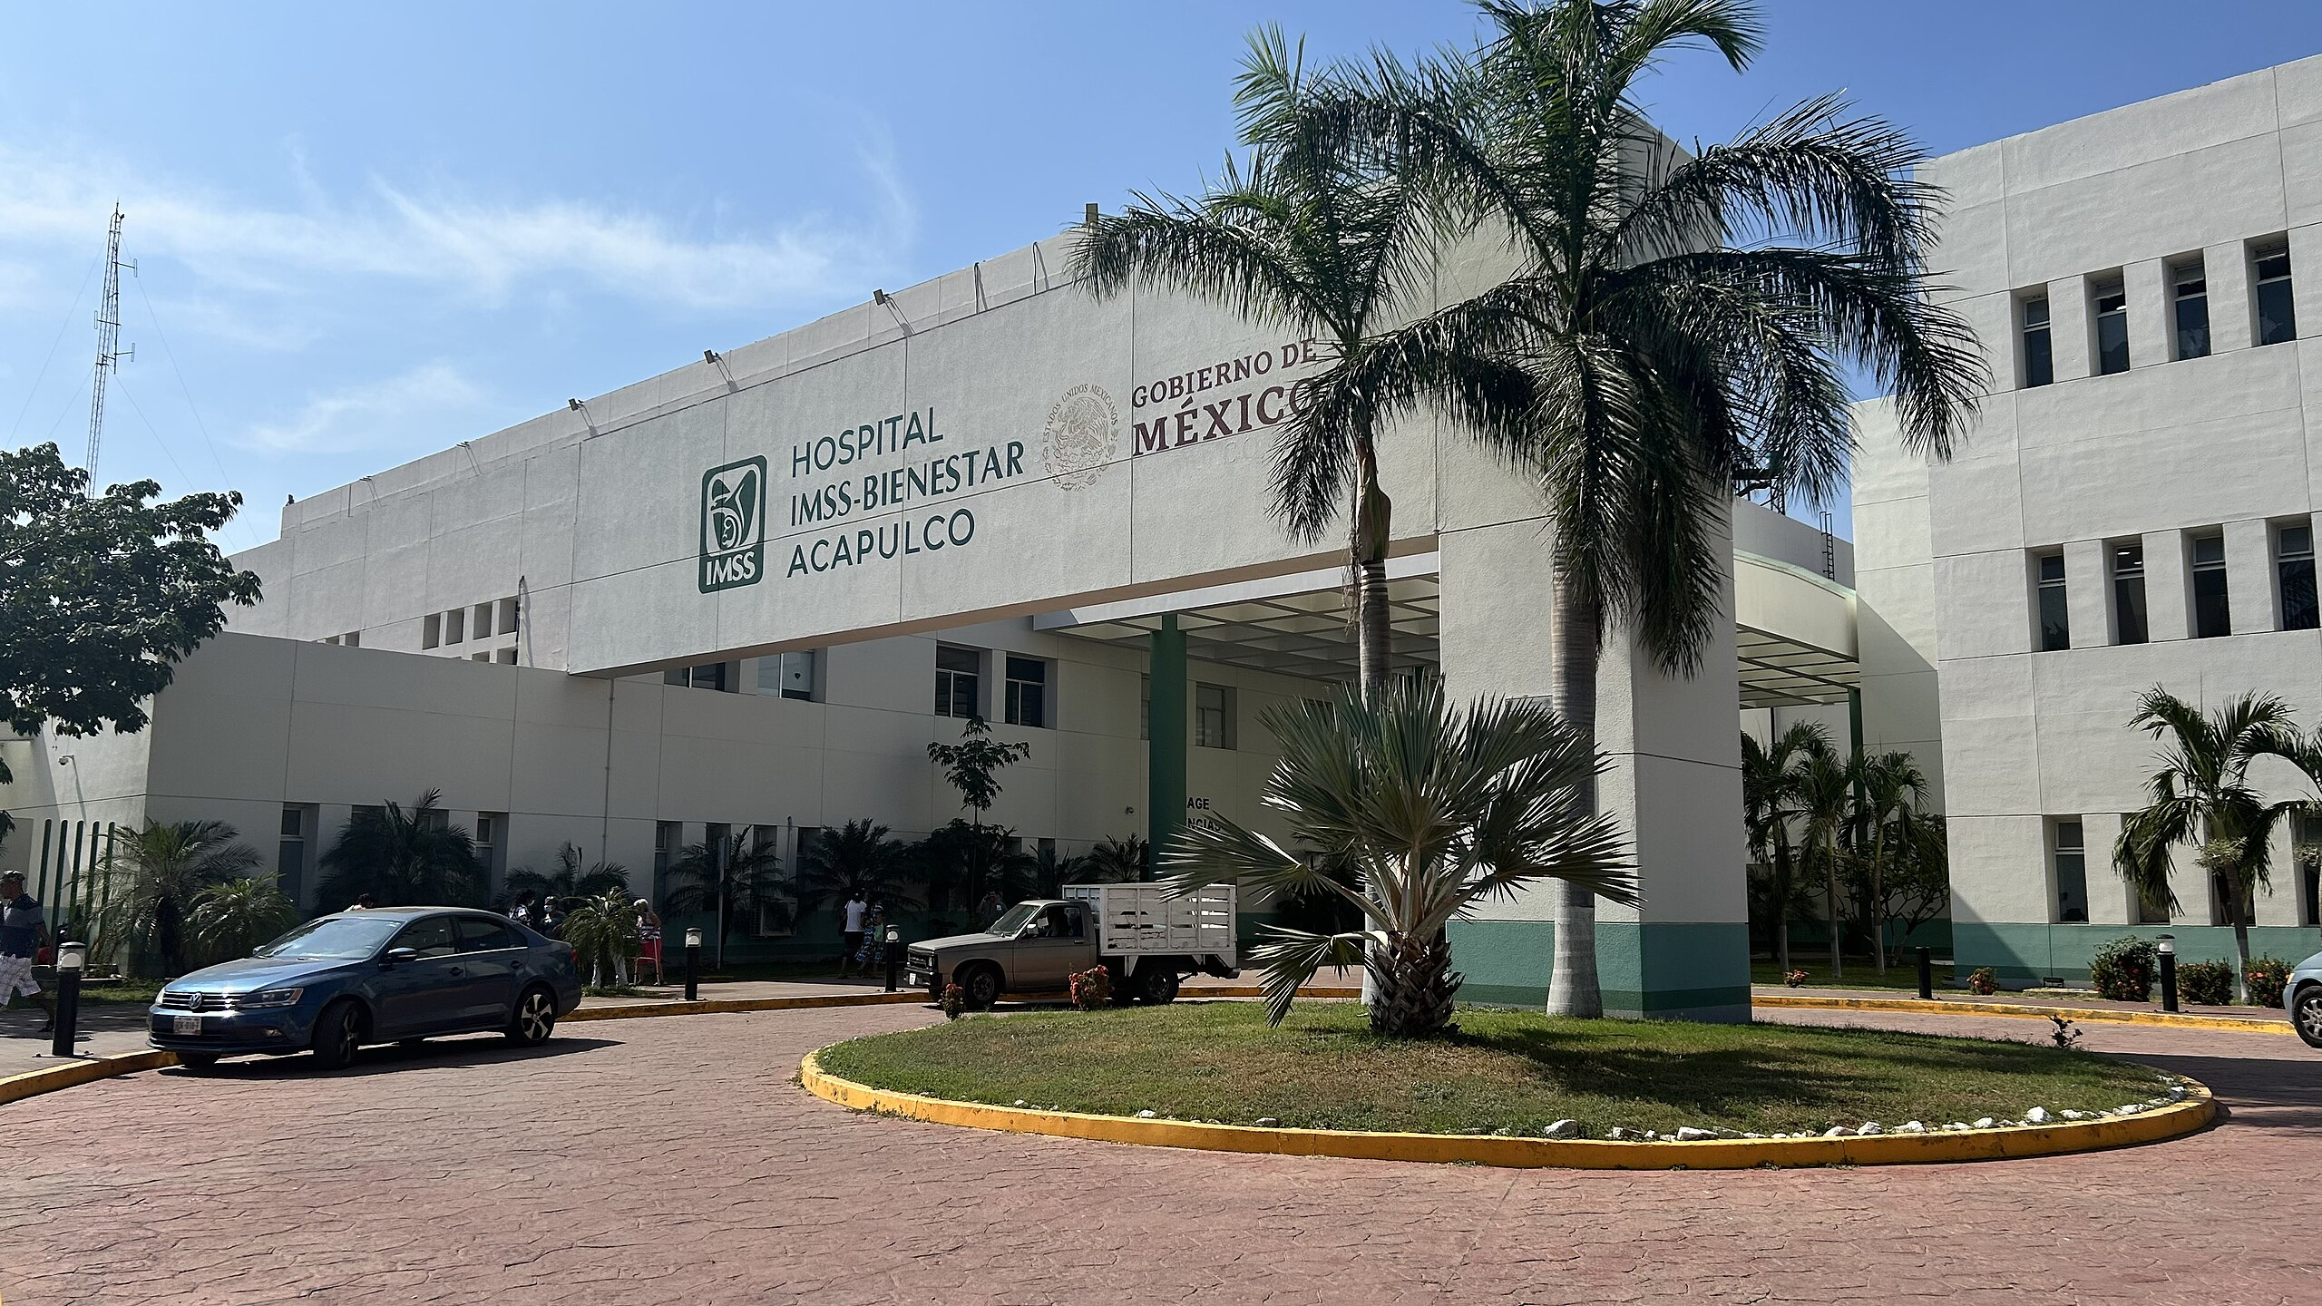
ACCESS TO HEALTH

Slide 4
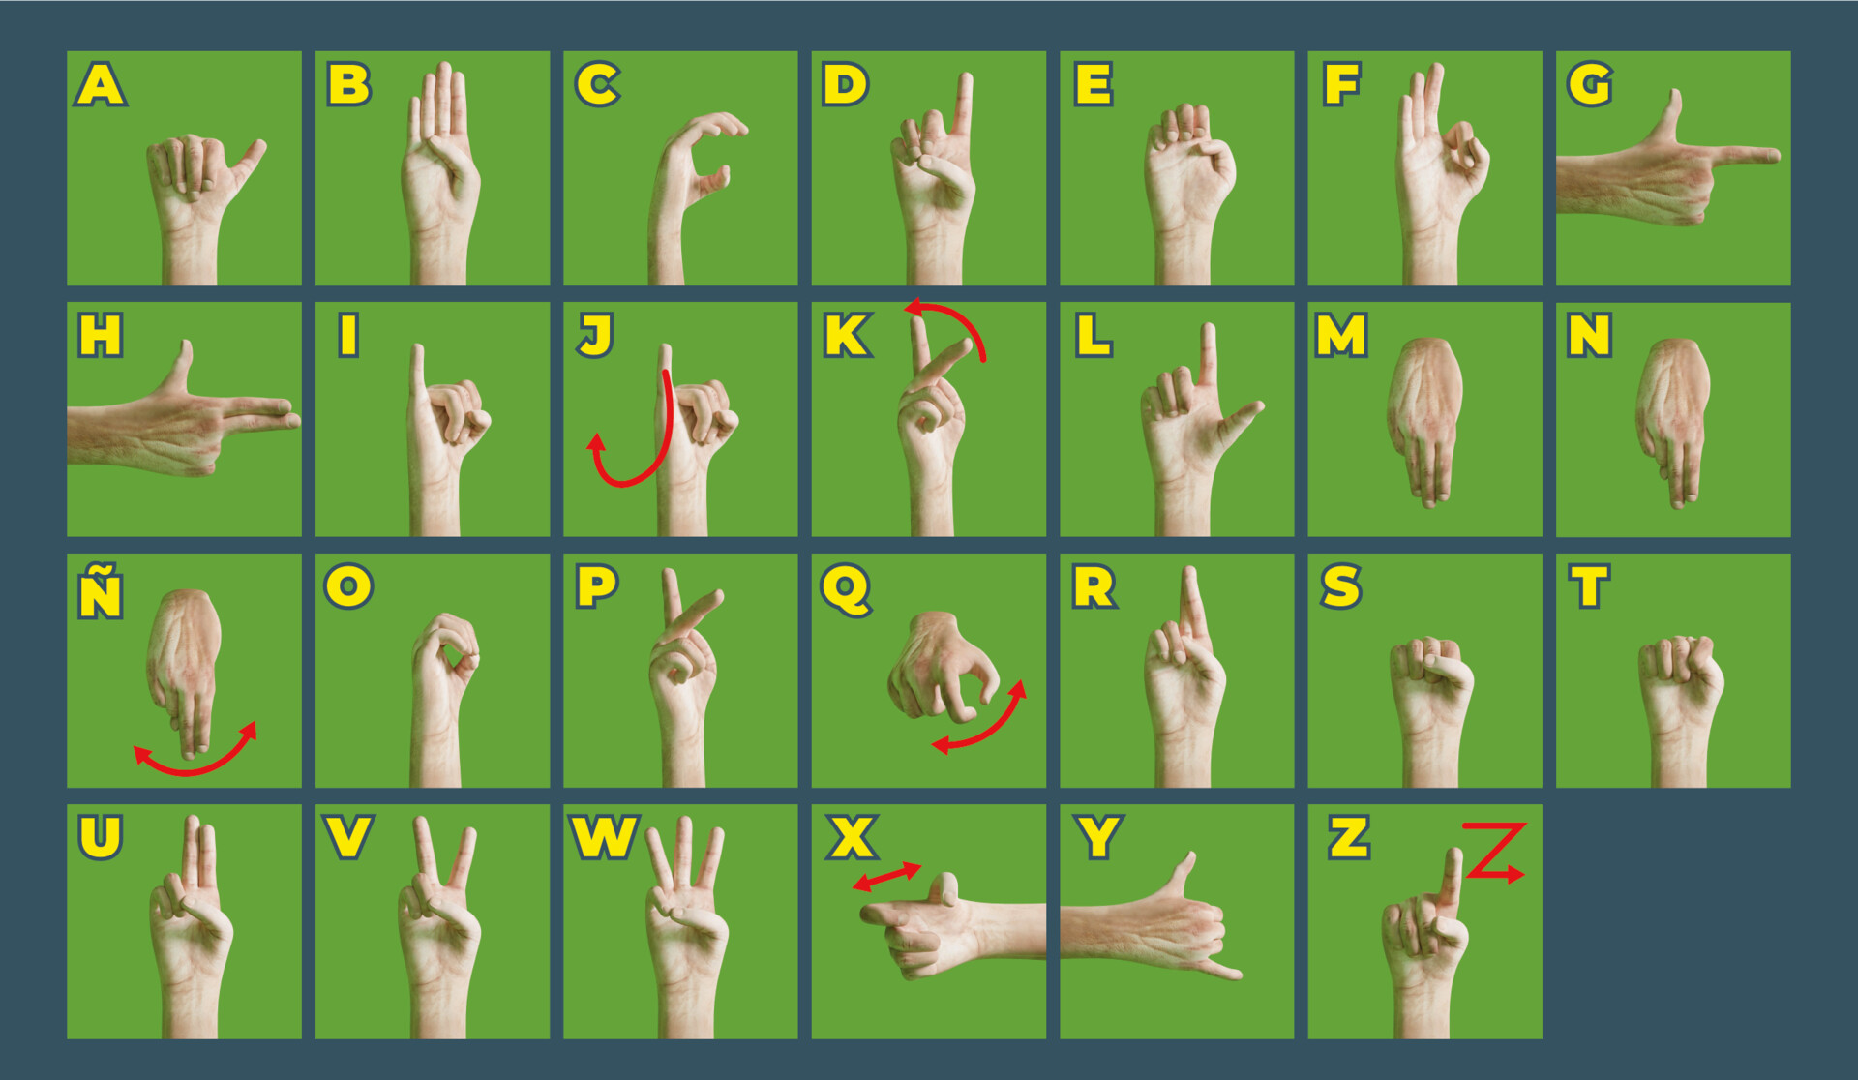
MEXICAN SIGN LANGUAGE

Slide 5
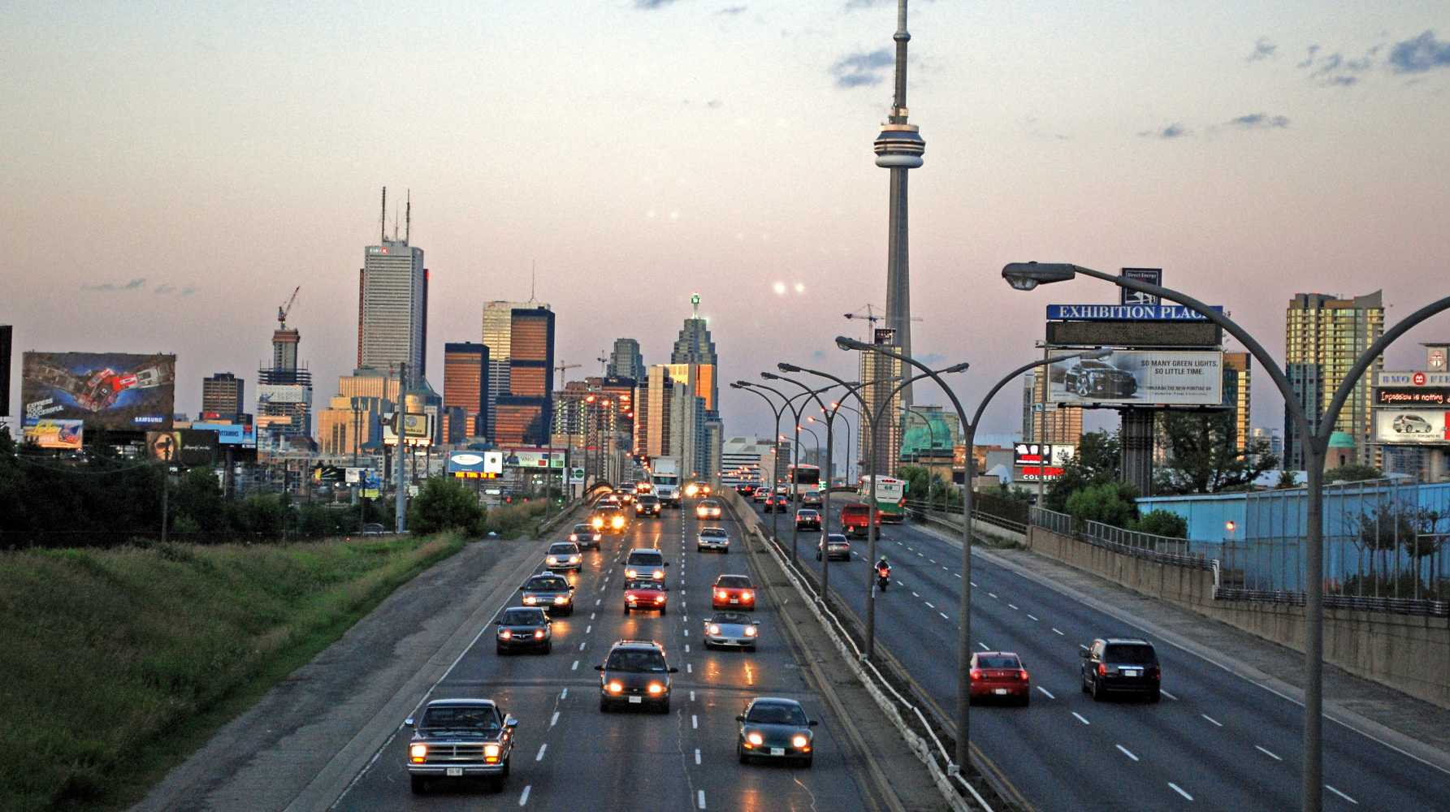
TORONTO SAS SAFE ROADS

Slide 6
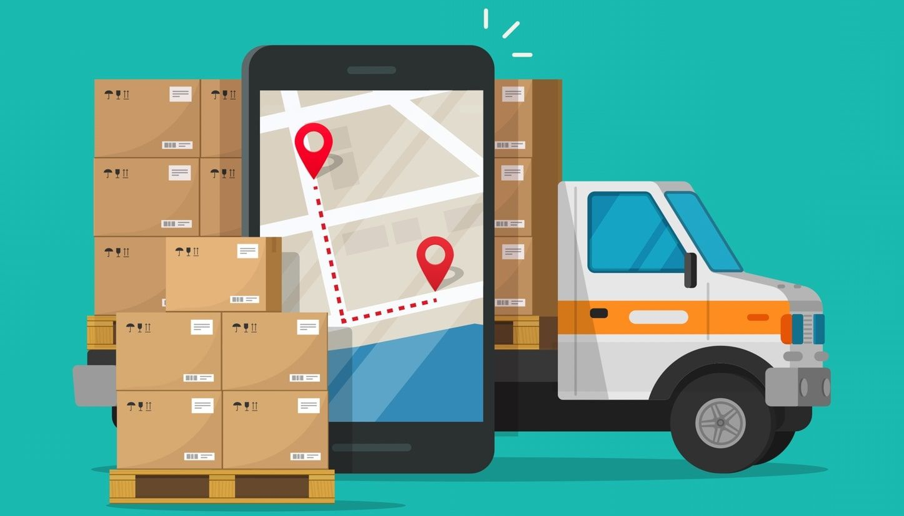
COPPEL ROUTE OPTIMIZATION

Slide 7

DIABETES CLASSIFICATION

Slide 8
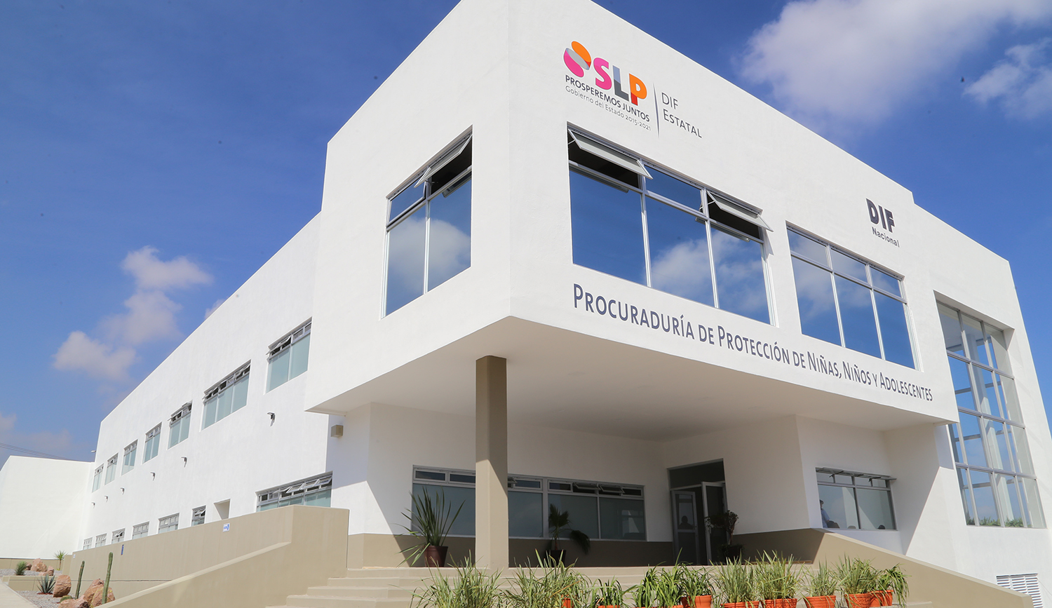
DIF VIOLENCE ANALYSIS

Slide 9
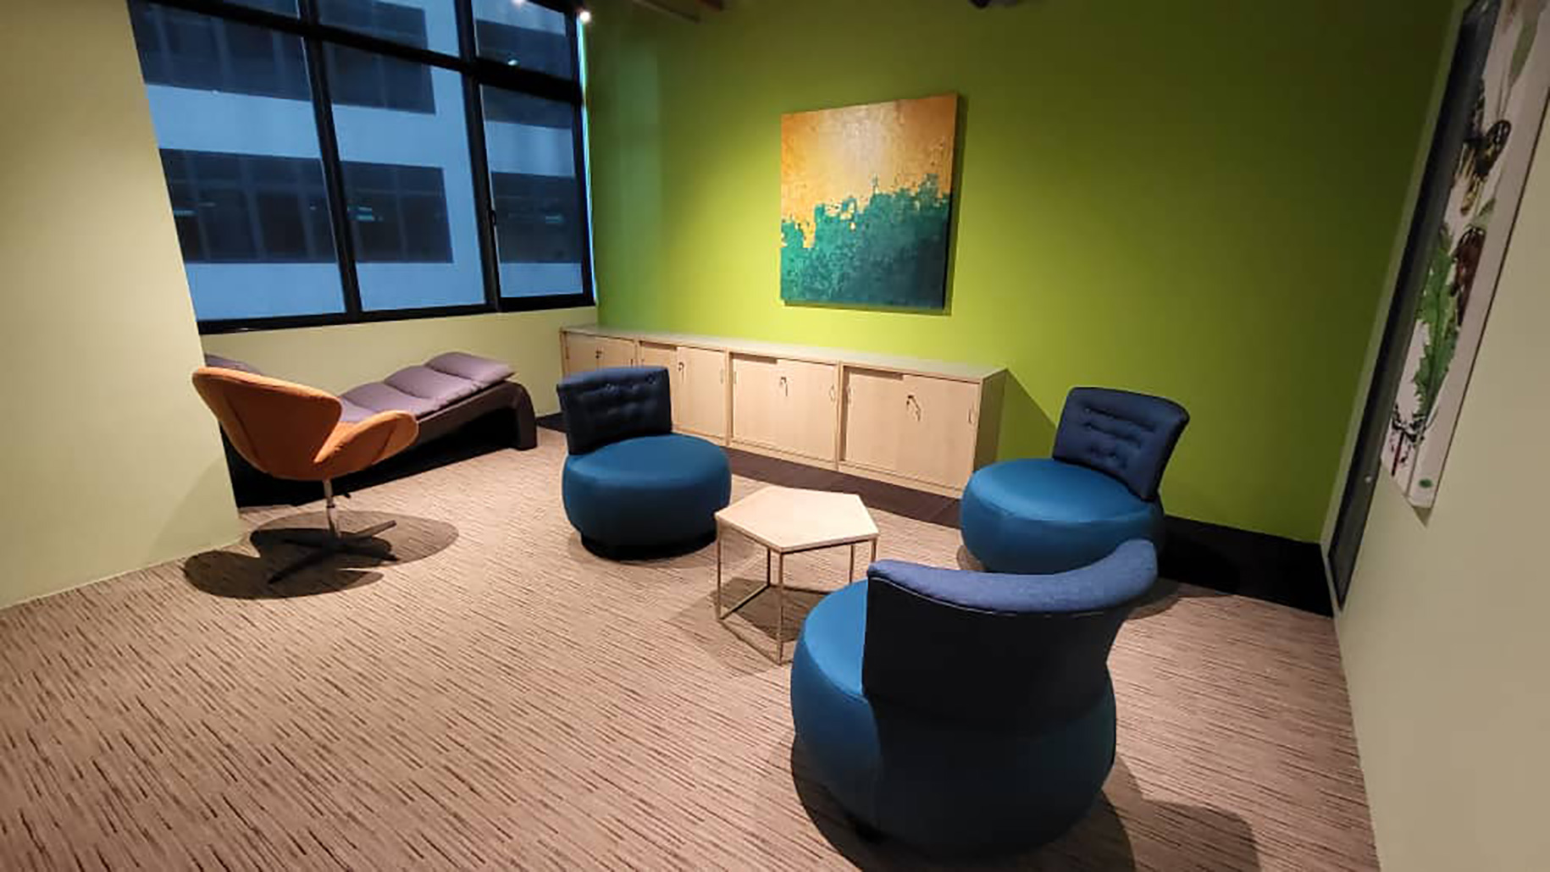
REFLEXION BUDDY

Slide 10
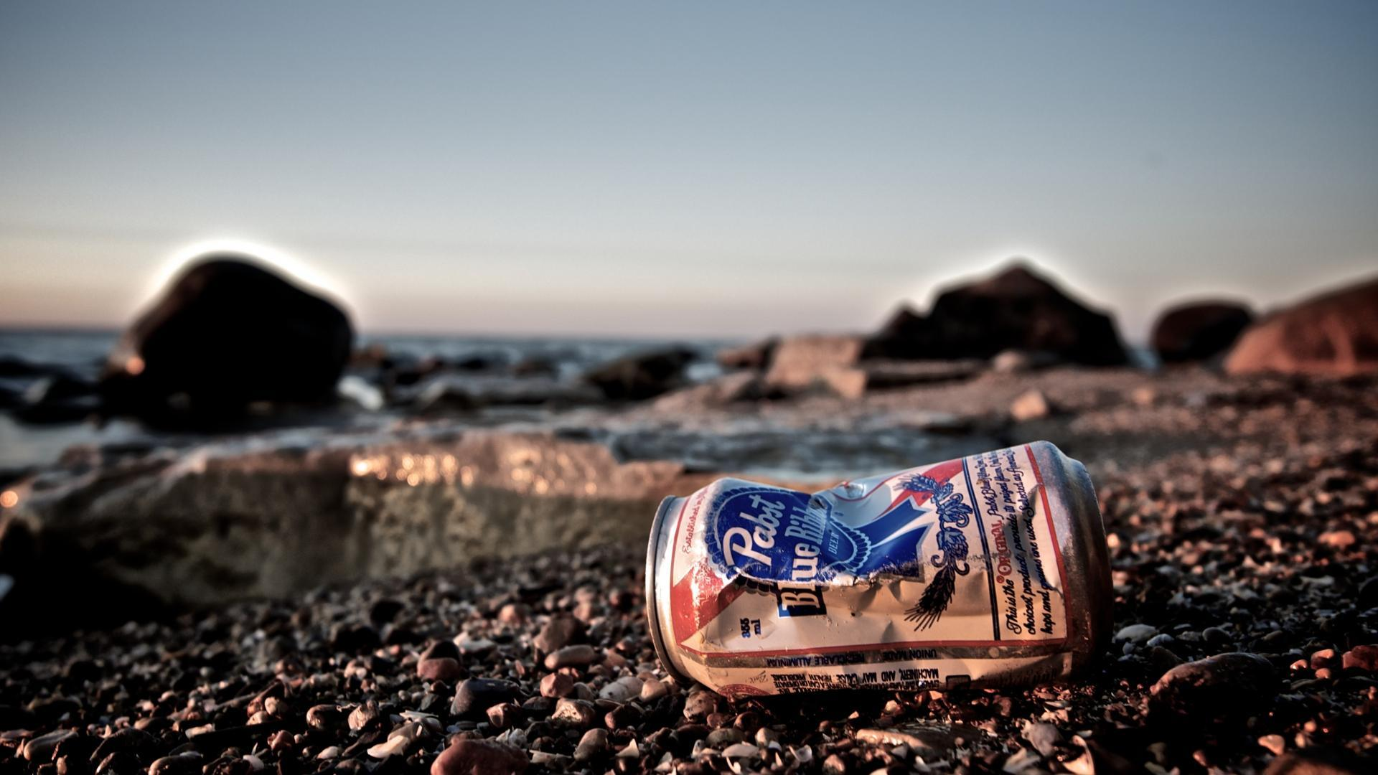
WASTE
WIZARD

Slide 11

CROP N’
SOIL

Slide 12

SUSTAINABLE
AF

Slide 13
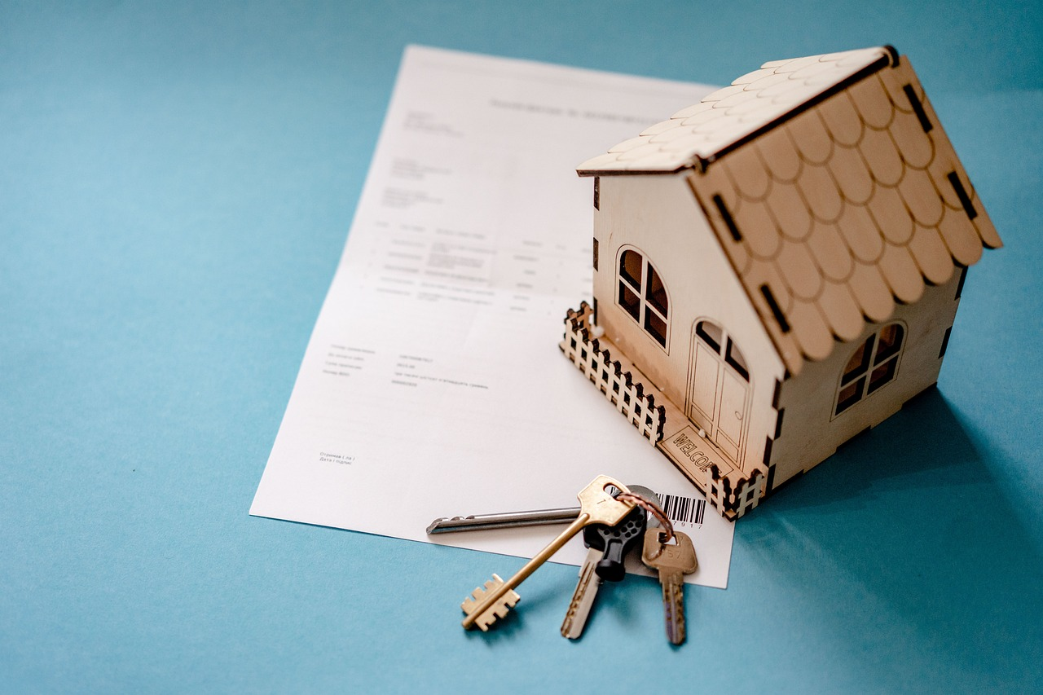
MOVE OUT WITH US

Slide 14

CARBON
CUT

Slide 15

WATER
AI

Slide 16

BANKING CREDIT ANALYSIS

